Slide 1
Healthy Body
Chapter 3: Using Energy
Friday, March 19th, 2020

Slide 2
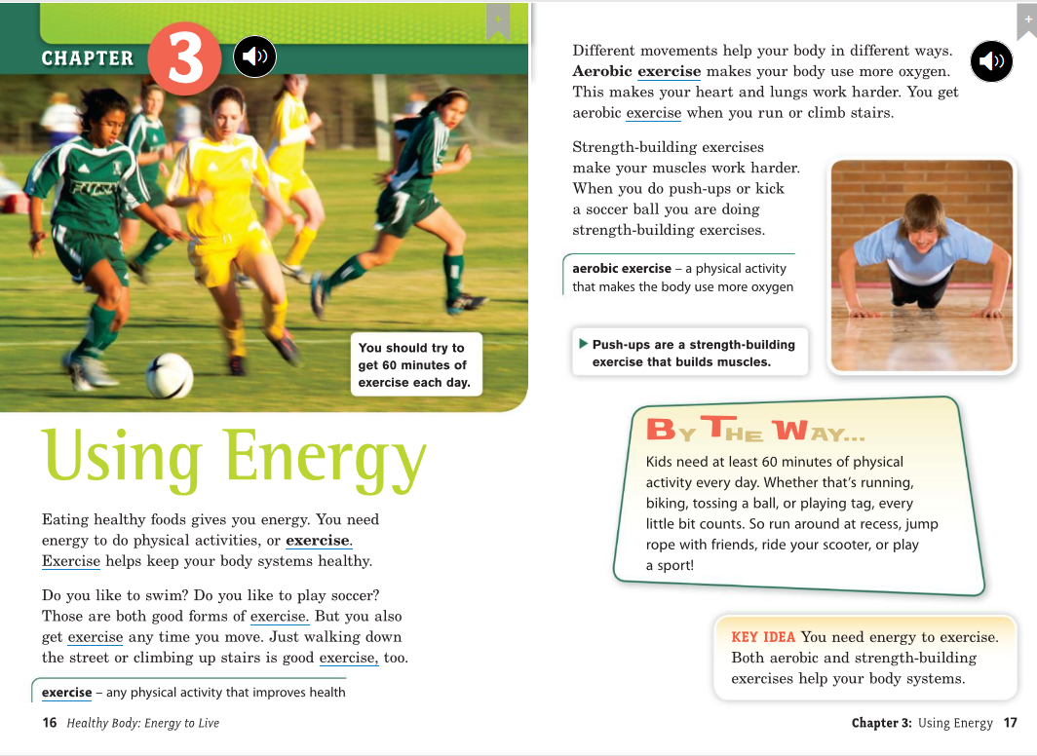

Slide 3
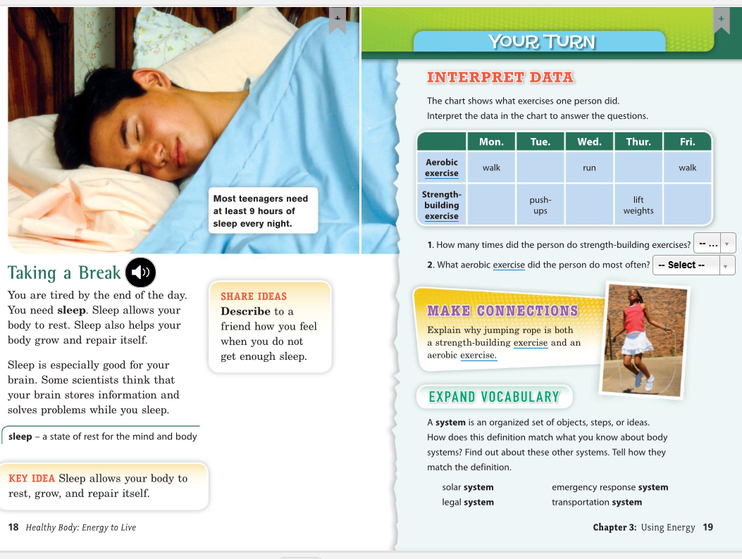

Slide 4
After you read the Chapter 3, answer the questions:
How any minutes of exercise is suggested in the image in page 16?
Mention a form of exercise that you like to do:
What kind of exercise is the boy on page 17 doing?
How does sleep helps your body?
How many hours of sleep did you take last night?
Look at the table in page 19 and tell me what exercise the person do every day and tell if is aerobic exercise or strength-building exercise.
Monday:
Tuesday:
Wednesday:
Thursday:
Friday:

